Slide 1
Azure Data Lake & Factory Level – 400 – Day 1
Sashank Pappu
Azure Data & AI Specialist

Slide 2


Sashank Pappu
Azure Data & AI Specialist.
Certified from MIT on ‘Advanced Analytics and Big Data Challenges’. Technology Enthusiast and Data Specialist. Certified Designer in Computer Vision
• Microsoft Certified Azure Data Architect. • Microsoft Certified Azure Machine Learning Developer • Certified on Practical Data Analytics with Microsoft Cortana Intelligence Suite.
9+ years of total experience as Data Specialist and Data Engineer.
Certifications
Experience
Currently working as Independent Consultant on Azure Data & AI and Enterprise Trainer on Azure Data Analytics , Cortana Intelligence Suite and Cognitive Sciences
Expert facilitator and corporate behavioral trainer with 5 years of experience in designing programs, content development , Data Analytics and Machine Learning.
Role
Training
Sri Nag Sashank
You can see me on – Sashankpappu.com

Slide 3




The session will span for 5 days & it is mandatory to attend all the days.
Self-Paced labs have been developed & access will be shared during the session.
The audience can participate in the leaning. However, it DOES NOT come with “Azure Subscriptions” & request users to arrange on their own.
A proctor will be available to take your queries via “Chat” window. Kindly “MUTE” and do not disturb the presenter.
The sessions are recorded. Will be made available through LMS at the end of series.
Note: More trainings on the same & similar topics would be delivered in near future. Keep your options open.
Guidelines for the event

Slide 4
Data Factory

Slide 5
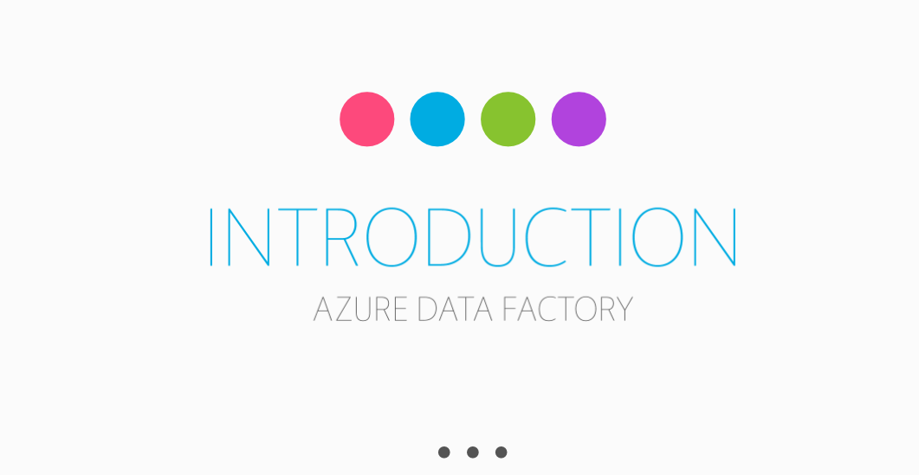

Slide 6
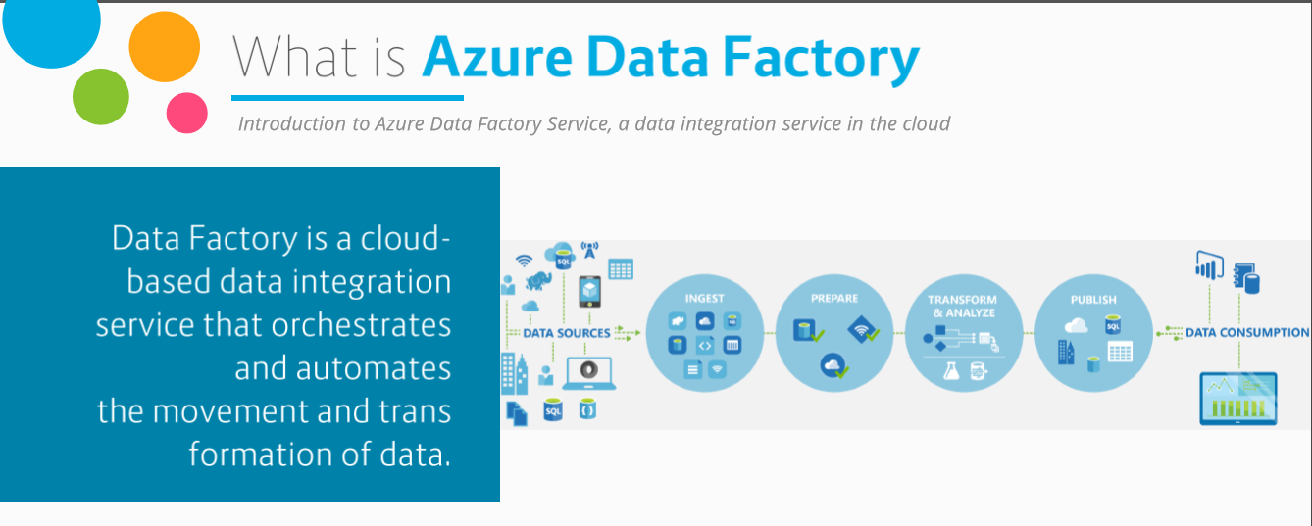
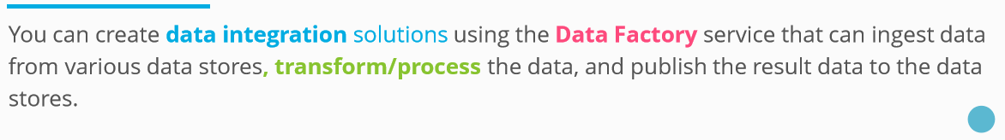

Slide 7
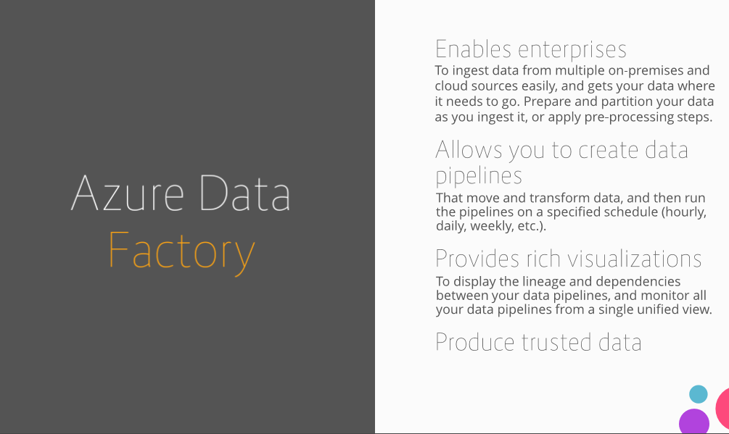

Slide 8
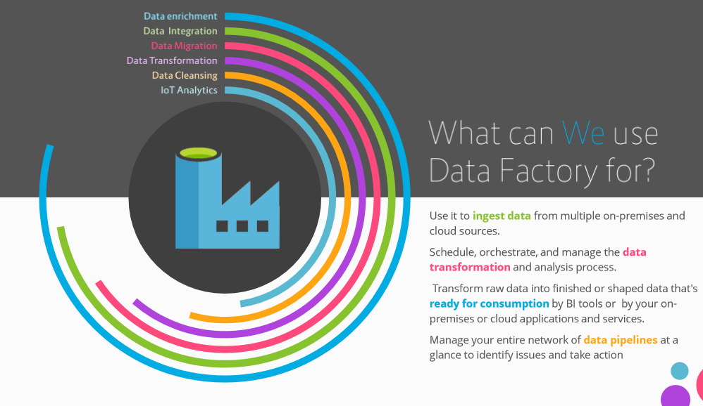

Slide 9
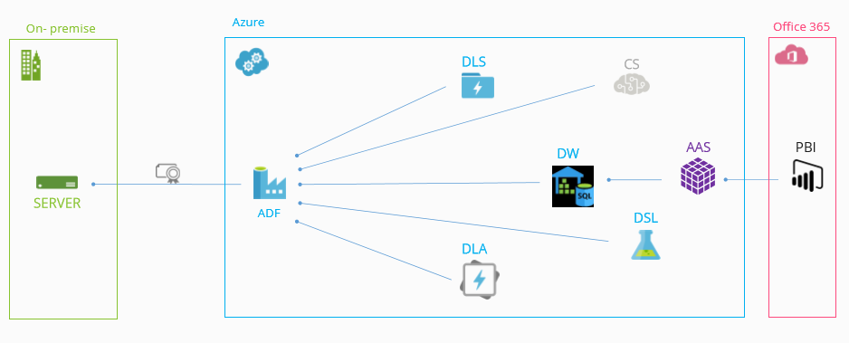
Data Sources Usage

Slide 10
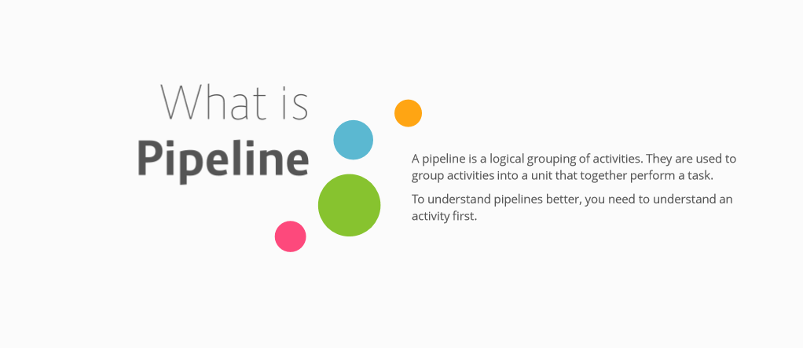

Slide 11
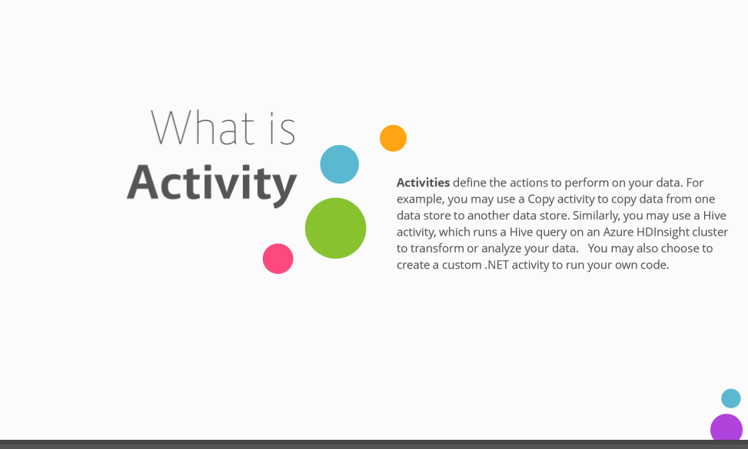

Slide 12
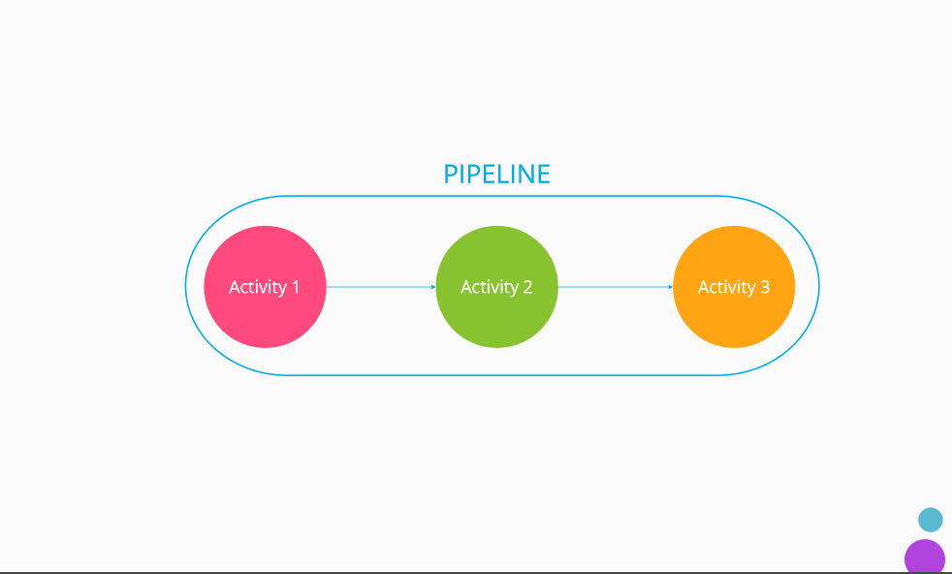

Slide 13
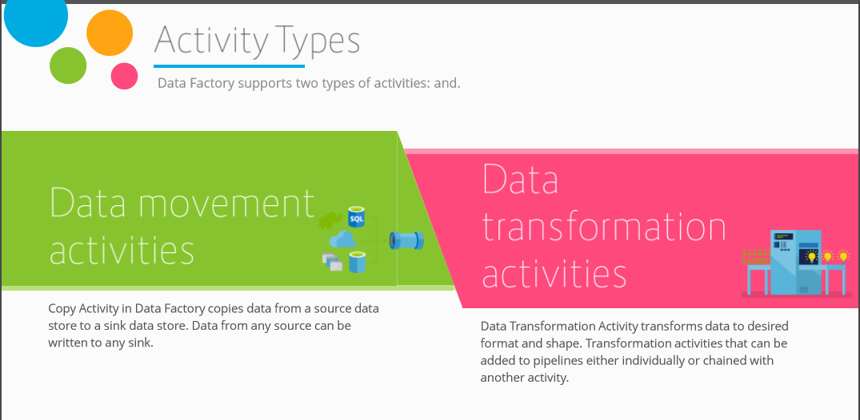

Slide 14
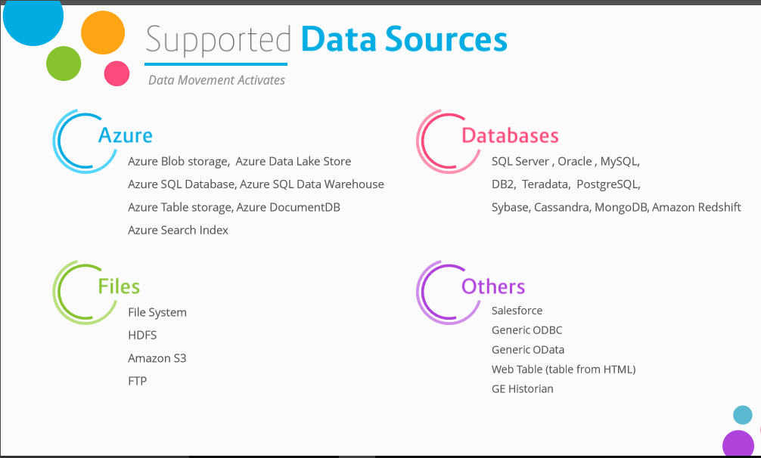

Slide 15
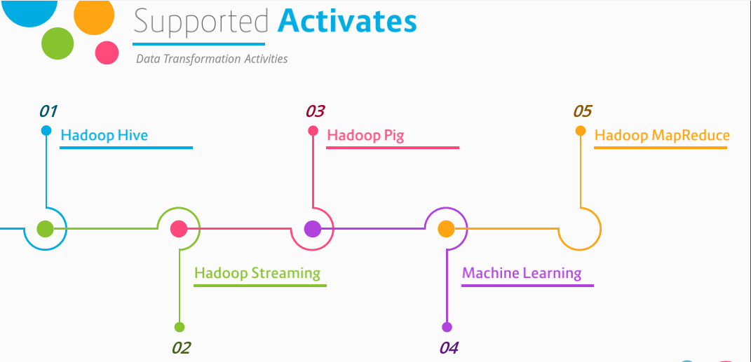

Slide 16
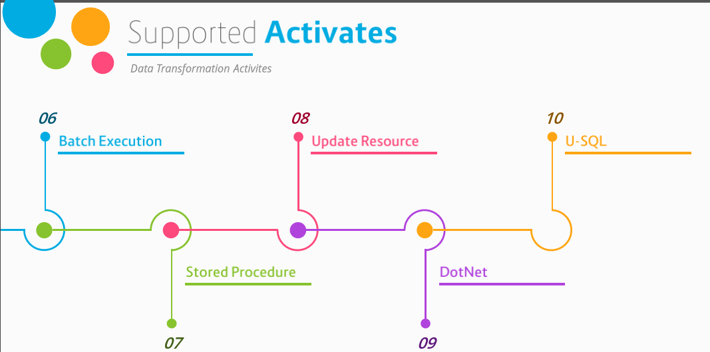

Slide 17
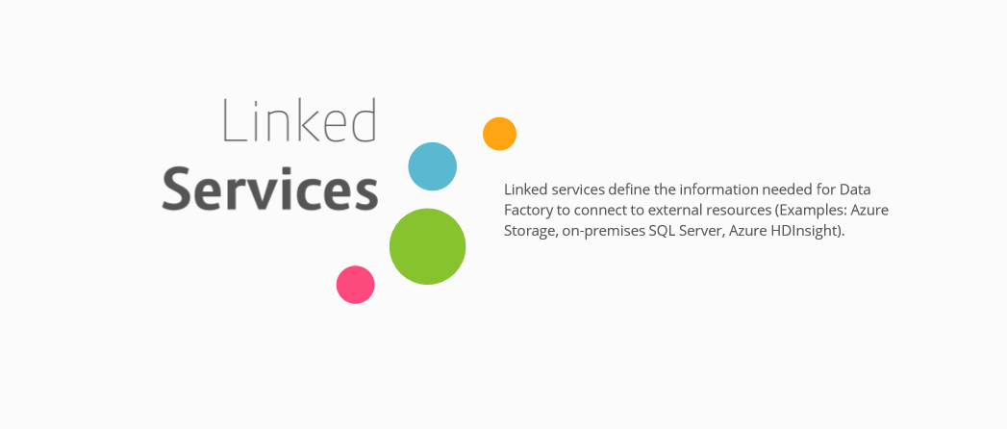

Slide 18
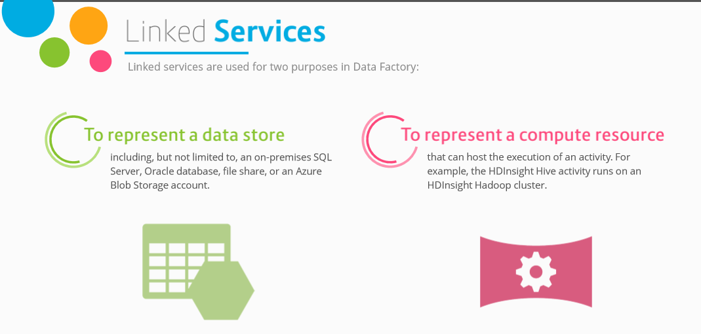

Slide 19
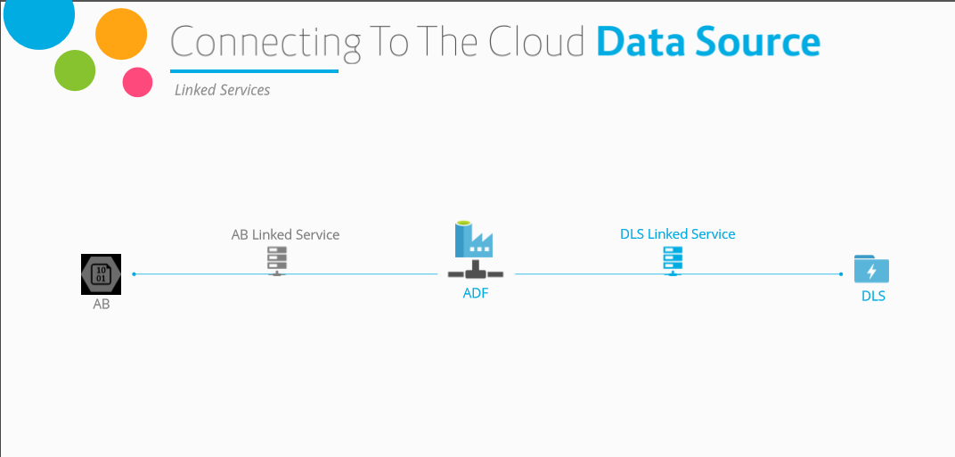

Slide 20
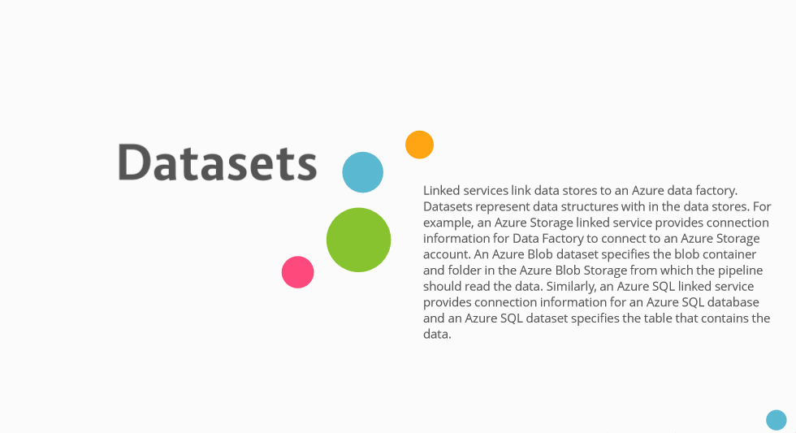

Slide 21
Hands on Copy Activity, Monitoring

Slide 22
2. Create the Data Factory
Portal, PowerShell and Visual Studio
Notes:
Setting Up: https://azure.microsoft.com/en-us/documentation/articles/data-factory-build-your-first-pipeline/

Slide 23
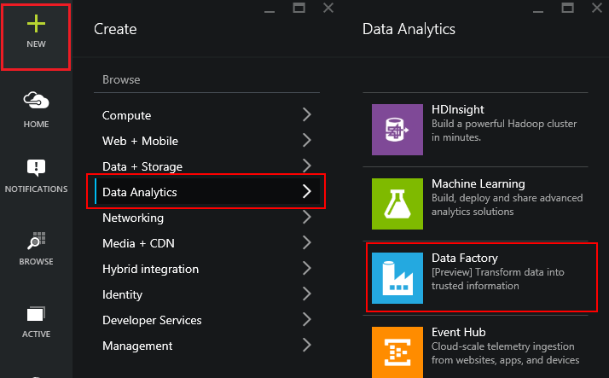
Using the Portal
Use in Non-MS Clients
Use for Exploration
Use when teaching or in a Demo
Notes:
LAB 2:
Open the file StudentWorkbook.txt
Complete Lab 2
Overview: https://azure.microsoft.com/en-us/documentation/articles/data-factory-build-your-first-pipeline/
Using the Portal: https://azure.microsoft.com/en-us/documentation/articles/data-factory-build-your-first-pipeline-using-editor/

Slide 24
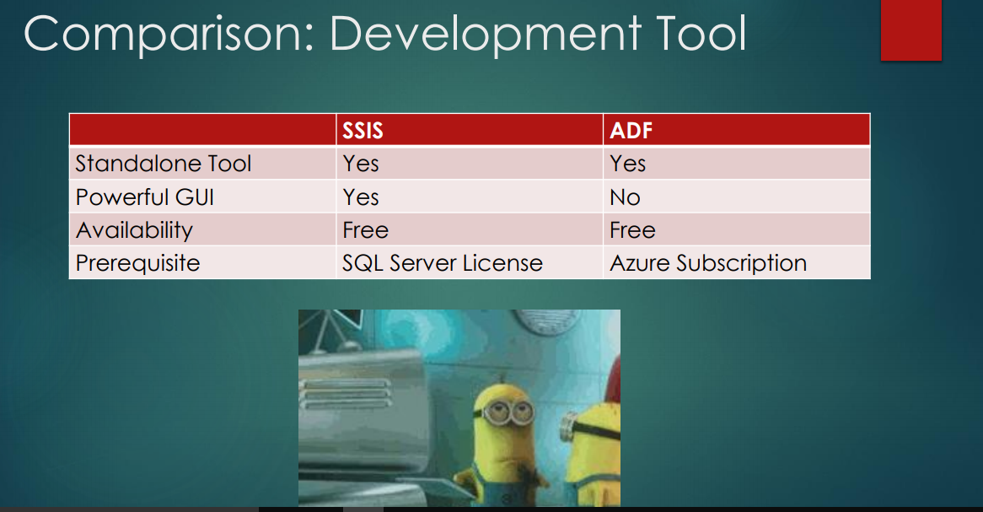

Slide 25
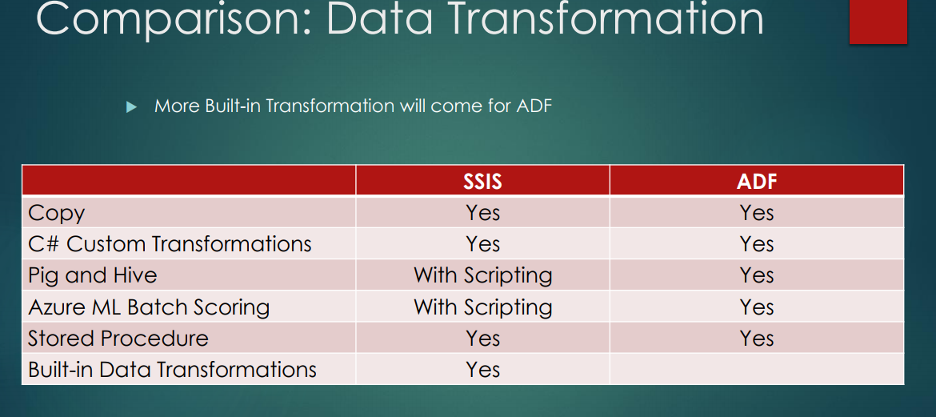

Slide 26
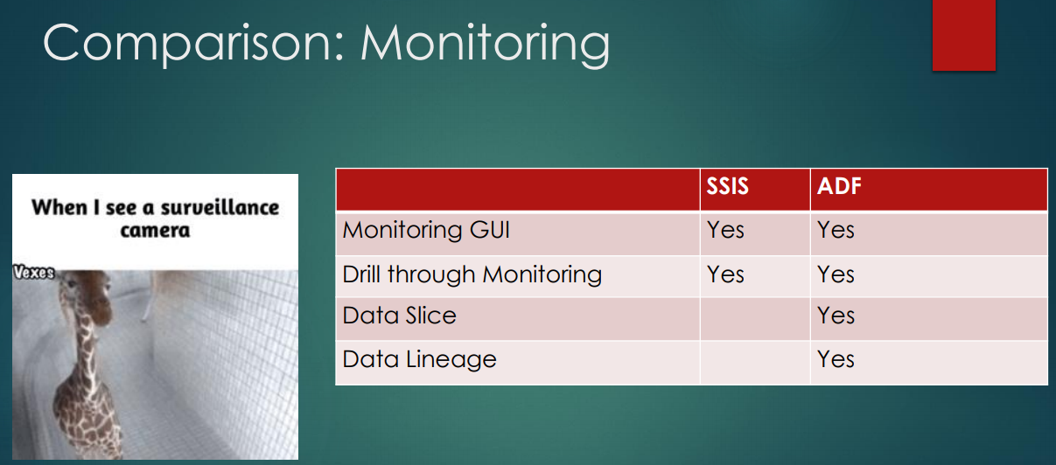

Slide 27
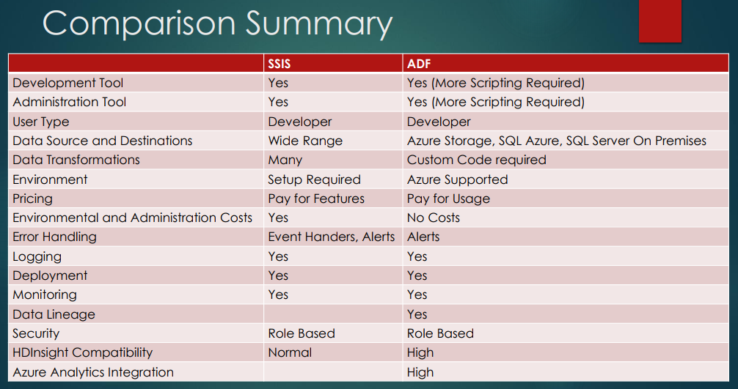

Slide 28
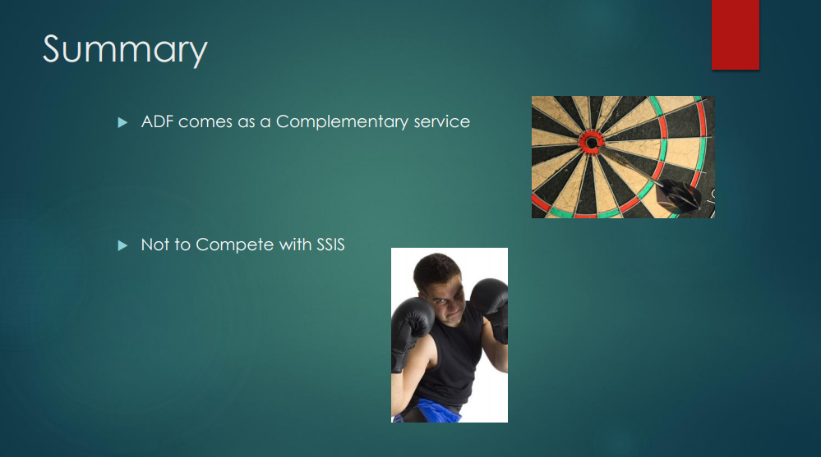

Slide 29
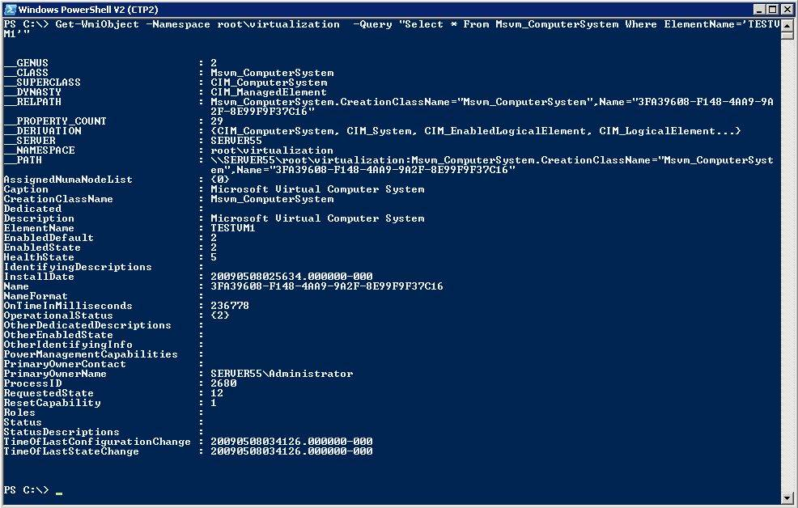
Using PowerShell
Use in MS Clients
Use for Automation
Use for quick set up and tear down
Notes:
Learning Path: https://azure.microsoft.com/en-us/documentation/articles/data-factory-introduction/
Full Tutorial: https://azure.microsoft.com/en-us/documentation/articles/data-factory-build-your-first-pipeline/

Slide 30
PowerShell ADF Example
Run Add-AzureAccount and enter the user name and password
Run Get-AzureSubscription to view all the subscriptions for this account.
Run Select-AzureSubscription to select the subscription that you want to work with.
Run Switch-AzureMode AzureResourceManager
Run New-AzureResourceGroup -Name ADFTutorialResourceGroup -Location "West US"
Run New-AzureDataFactory -ResourceGroupName ADFTutorialResourceGroup –Name DataFactory(your alias)Pipeline –Location "West US"
Notes:
https://azure.microsoft.com/en-us/documentation/articles/data-factory-build-your-first-pipeline-using-powershell/

Slide 31
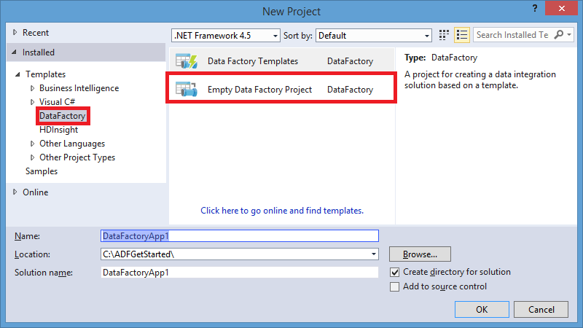
Using Visual Studio
Use in mature dev environments
Use when integrated into larger development process
Notes:
Overview: https://azure.microsoft.com/en-us/documentation/articles/data-factory-build-your-first-pipeline/
Using the Portal: https://azure.microsoft.com/en-us/documentation/articles/data-factory-build-your-first-pipeline-using-editor/

Slide 32
ADF V2

Slide 33
Concepts
Data Source
Dataset
Pipeline
is a grouping of logically related activities. It is used to group activities into a unit that performs a task
Concepts
Activities define the actions to perform on your data. Each activity takes zero or more datasets as inputs and produces one or more datasets as output.
Activity
Linked services
computing environment
Notes:
We have four main concepts.
First. Dataset is data source
Second. Activity. It’s actions to perform on your data
Third. Pipeline. It’s a grouping of logically related activities
And finally. Linked services are computing environment or external resource. For example It’ s Hive, Machine Learning, stored procedure
Let’s look at these concepts in more detail

Slide 34
Expressions & Parameters
String functions – concat, substring, replace, indexof etc.
Collection functions – length, union, first, last etc.
Logic functions – equals, less than, greater than, and, or, not etc.
Conversation functions – coalesce, xpath, array, int, string, json etc.
Math functions – add, sub, div, mod, min, max etc.
Date functions – utcnow, addminutes, addhours, format etc.

Slide 35
System variables
Pipeline scope
Trigger scope
Variable Name
@pipeline().DataFactory
@pipeline().Pipeline
@pipeline().RunId
@pipeline().TriggerType
@pipeline().TriggerId
@pipeline().TriggerName
@pipeline().TriggerTime
Variable Name
trigger().scheduledTime
trigger().startTime

Slide 36
Trigger

Slide 37
Type of triggers
Manual execution
Schedule trigger: A trigger that invokes a pipeline on a wall-clock schedule.
Tumbling window trigger: A trigger that operates on a periodic interval, while also retaining state.

Slide 38
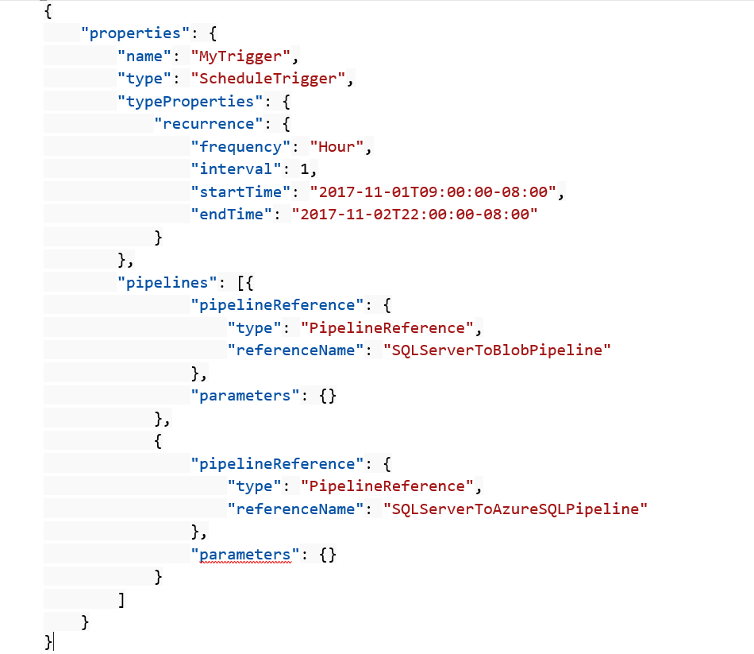
Schedule trigger
A schedule trigger runs pipelines on a wall-clock schedule. This trigger supports periodic and advanced calendar options. For example, the trigger supports intervals like "weekly" or "Monday at 5:00 PM and Thursday at 9:00 PM."

Slide 39
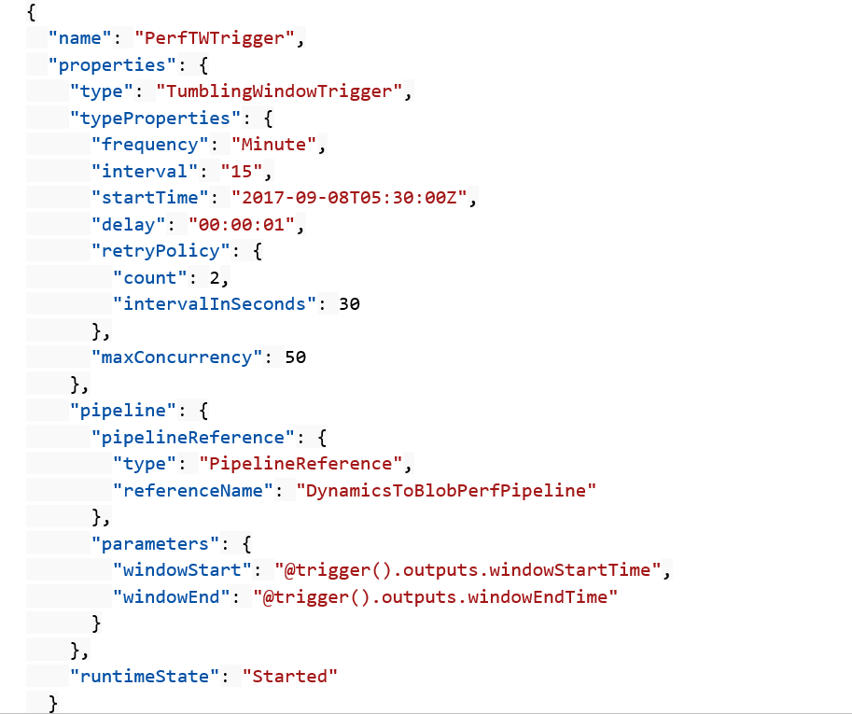
Tumbling window trigger
Tumbling window triggers are a type of trigger that fires at a periodic time interval from a specified start time, while retaining state. Tumbling windows are a series of fixed-sized, non-overlapping, and contiguous time intervals.

Slide 40
Control flow

Slide 41
Control flow
Filter activity
ForEach activity
Get metadata
Execute Pipeline
If Condition activity
Web activity
Lookup activity
Wait activity
Until activity

Slide 42
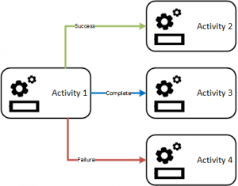
Branching
On success
On failure
On completion
On skip

Slide 43
Hands on Usecase

Slide 44
Usecase
One of the Manufacturing client needs data coming from multiple sources to be automated to generate reports and even send the email at the end.
This should be a one time creation of pipeline but any new source integration should not impact the pipeline process.

Slide 45
Build 2019
Whats New !!!

Slide 57
Future is most promising for ADF
Data Flows are in General Available

Slide 58
Hands on Usecase

Slide 59
Usecase
One of the client needs data coming from multiple sources to be automated to generate reports and even send the email at the end.
This should be a one time creation of pipeline but any new source integration should not impact the pipeline process.

